Slide 1
Deep Neural Networks: Attention Mechanism and Transformers
CS771: Introduction to Machine Learning
Piyush Rai

Slide 2










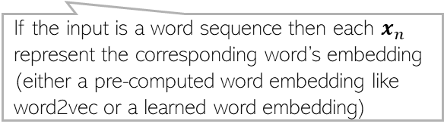




























Recap: RNNs
2
RNNs are used when each input or output or both are sequences of tokens
Hidden state $h_{t}$ is supposed to remember everything up to time $t−1$. However, in practice, RNNs have difficulties remembering the distant past
Variants such as LSTM, GRU, etc mitigate this issue to some extent
Slow processing is another major issue (e.g., can’t compute $h_{t}$ before computing $h_{t−1}$)
$$y_{1}$$
$$y_{2}$$
$$y_{3}$$
$$y_{t}$$
Decoder part
$$y_{T}$$
$$y_{t}$$
$$v$$
$$v$$
$$v$$
$$v$$
$$v$$
Compactly
$$v$$
$$h_{1}$$
$$U$$
$$h_{2}$$
$$U$$
$$h_{3}$$
$$U$$
$$U$$
$$h_{t}$$
$$U$$
$$U$$
$$h_{T}$$
$$h_{t}$$
$$U$$
$$W$$
$$W$$
$$W$$
$$W$$
$$W$$
$$W$$
$$x_{1}$$
$$x_{2}$$
$$x_{3}$$
$$x_{t}$$
Encoder part
$$x_{T}$$
$$x_{t}$$
If the input is a word sequence then each $x_{n}$ represent the corresponding word’s embedding (either a pre-computed word embedding like word2vec or a learned word embedding)

Slide 3
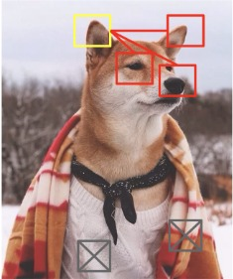
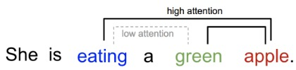
Attention
3
We use attention to “focus” on some part of interest in an input
Other nearby relevant parts help us focus
Other irrelevant parts do not contribute in the process
In sequence modeling problems, we can use attention between input and output tokens (between encoder and decoder parts), as well as among the inputs only (only within the encoder part)
Pic credit: https://lilianweng.github.io/posts/2018-06-24-attention/

Slide 4
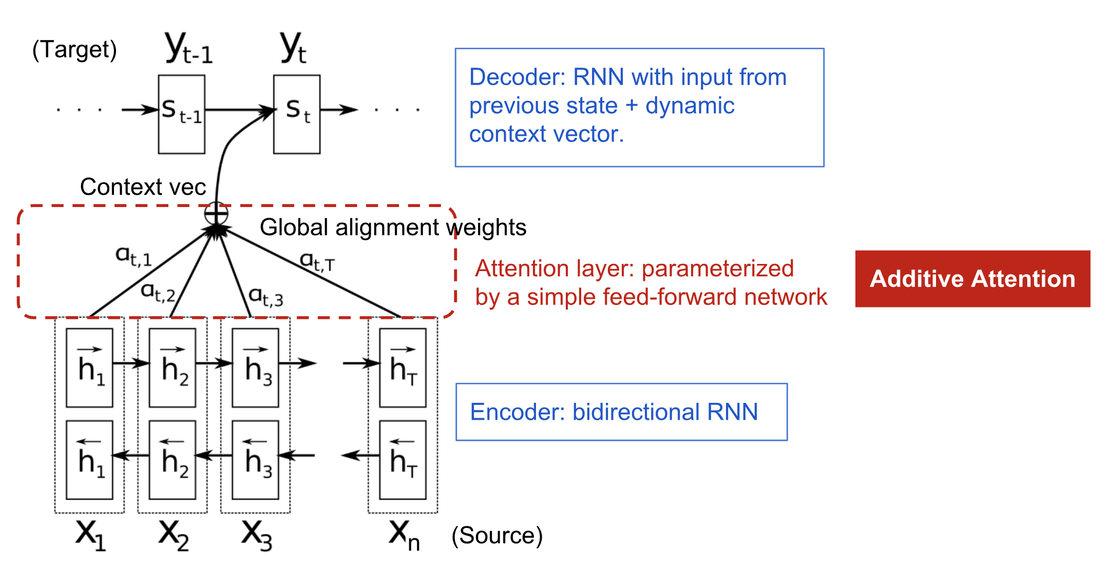


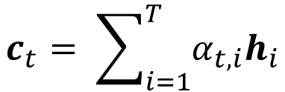

RNN with Attention
4
RNNs have also been augmented with attention to help remember the distant past
Attention mechanism for a bi-directional RNN encoder-decoder model
$$s_{t}=f(s_{t−1}, c_{t})$$
Decoder’s output $y_{t}$ at step $t$ assumed to depend on the previous state $s_{t−1}$ in the decoder and an input context vector $c_{t}$
$$h_{i}= \left[\begin{aligned}{\vec{h}}_{i} \\ {\overset{⃖}{h}}_{i}\end{aligned}\right]$$
$$c_{t}= \sum_{i=1}^{T}{α_{t,i}h_{i}}$$
T

Slide 5

Self-Attention
5
With self-attention, each token $x_{n}$ can “attend to” all other tokens when the encoder computes its embedding $h_{n}$
Attention helps capture the context better and in a much more “global” manner
“Global”: Long ranges captures and in both directions (previous and ahead)
The input sequence but differing in the last word (tired -> wide)
An input sequence
How much the word “it” is being “attended to” by other words in the input sequence
Note how the attention has changed
Example credit: https://blog.research.google/2017/08/transformer-novel-neural-network.html

Slide 6
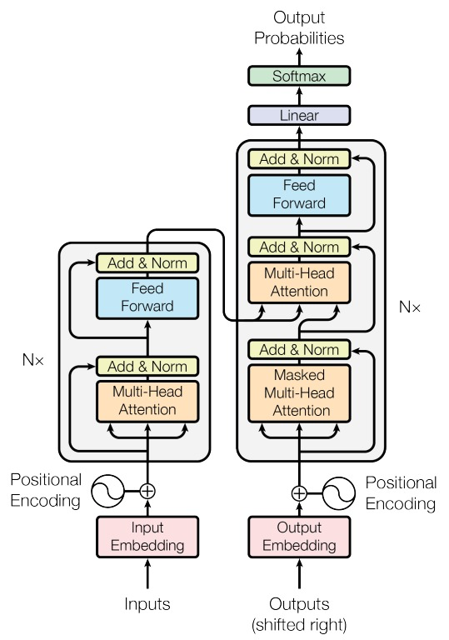
Transformers
6
Transformers also use the idea of attention
“self-attention” over all input tokens
“self-attention” over each output token and previous tokens
“cross-attention” between output tokens and input tokens
Transformer also compute embeddings of all tokens in parallel
Transformers are based on the following key ideas*
“Self-attention” and “cross-attention” for computing the hidden states
Positional encoding
Residual connections
Attention helps capture the context better and in a much more “global” manner in sequence data
“Attention is all you need” (Vaswani et al, 2017)

Slide 7


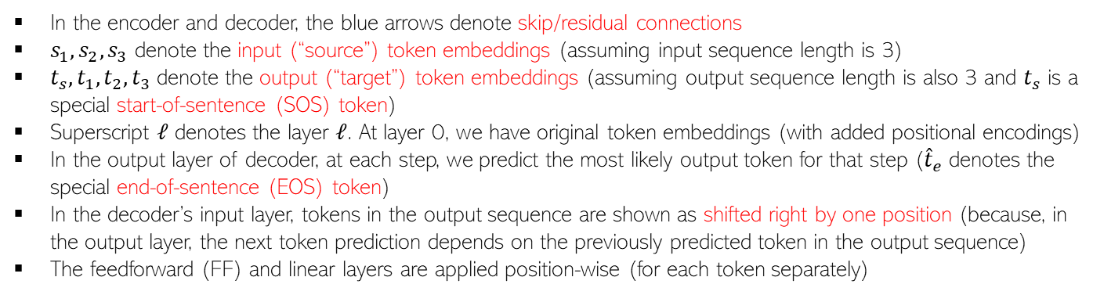














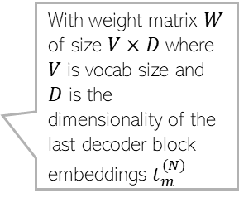







All Pieces..
7
In the encoder and decoder, the blue arrows denote skip/residual connections
$s_{1},s_{2},s_{3}$ denote the input (“source”) token embeddings (assuming input sequence length is 3)
$t_{s},t_{1},t_{2}, t_{3}$ denote the output (“target”) token embeddings (assuming output sequence length is also 3 and $t_{s}$ is a special start-of-sentence (SOS) token)
Superscript $ℓ$ denotes the layer $ℓ$. At layer 0, we have original token embeddings (with added positional encodings)
In the output layer of decoder, at each step, we predict the most likely output token for that step (${\hat{t}}_{e}$ denotes the special end-of-sentence (EOS) token)
In the decoder’s input layer, tokens in the output sequence are shown as shifted right by one position (because, in the output layer, the next token prediction depends on the previously predicted token in the output sequence)
The feedforward (FF) and linear layers are applied position-wise (for each token separately)
$$t_{s}^{(ℓ)}$$
$$t_{1}^{(ℓ)}$$
$$t_{2}^{(ℓ)}$$
$$t_{3}^{(ℓ)}$$
$${\hat{t}}_{m}^{(N)}= {argmax}_{i=1,…, V} softmax(Wt_{m}^{(N)})$$
$$s_{1}^{(ℓ)}$$
$$s_{2}^{(ℓ)}$$
$$s_{3}^{(ℓ)}$$
Layer Normalization
$${\hat{t}}_{1}^{(N)}$$
$${\hat{t}}_{2}^{(N)}$$
$${\hat{t}}_{3}^{(N)}$$
$${\hat{t}}_{e}^{(N)}$$
Note the one position (towards right) shift between decoder’s input vs output
FF
FF
FF
FF
Layer Normalization
Layer Normalization
Softmax
Softmax
Softmax
Softmax
With weight matrix $W$ of size $V×D$ where $V$ is vocab size and $D$ is the dimensionality of the last decoder block embeddings $t_{m}^{(N)}$
Overall Transformer
Architecture
FF
FF
FF
Cross-Attention Layer
Linear
Linear
Linear
Linear
Each FF (feed-forward)in encoder and decoder blocks is usually a linear layer + ReLU nonlinearity + another linear layer
Layer Normalization
Layer Normalization
$$t_{s}^{(N)}$$
$$t_{1}^{(N)}$$
$$t_{2}^{(N)}$$
$$t_{3}^{(N)}$$
Self-Attention Layer
Masked Self-Attention Layer
Decoder’s output layer
$$s_{1}^{(ℓ−1)}$$
$$s_{2}^{(ℓ−1)}$$
$$s_{3}^{(ℓ−1)}$$
$$t_{s}^{(ℓ−1)}$$
$$t_{1}^{(ℓ−1)}$$
$$t_{2}^{(ℓ−1)}$$
$$t_{3}^{(ℓ−1)}$$
An Encoder Block
(N such blocks)
A Decoder Block connected with the corresponding encoder block
(N such blocks)

Slide 8

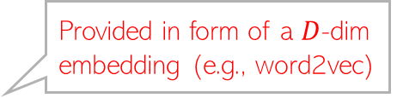

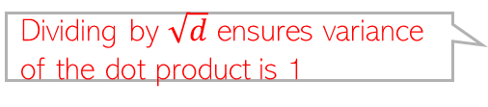


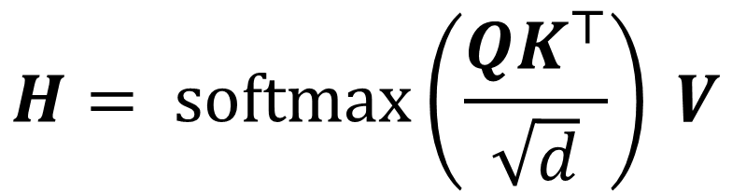
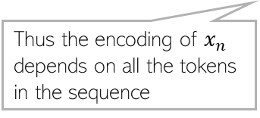




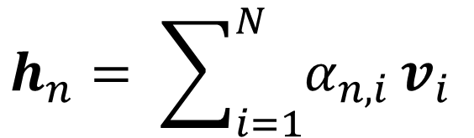
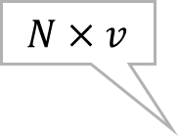





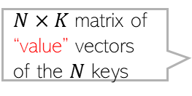
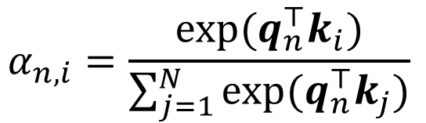


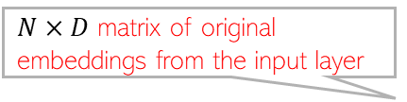
Self-Attention
8
Provided in form of a $D$-dim embedding (e.g., word2vec)
For an $N$ length sequence, the attention scores for each token $x_{n}$ are computed using
A query vector $q_{n}$ associated with that token
$N$ key vectors $K=\{k_{1},k_{2},…, k_{N}\}$ (one per token)
$N$ value vectors $V=\{v_{1},v_{2},…, v_{N}\}$ associated with the key vectors
One way to compute the attention score is
Given attention scores, encoder’s hidden state for $x_{n}$ is
$N×D$ matrix of original embeddings from the input layer
Linear projection by $D×d$ matrix
$N×d$matrix of “queries”
$$Q=XW_{Q}$$
Learnable
Row $n$ is $q_{n}$
$D×d$ matrix. Learnable
$N×d$matrix of $N$ “keys”
Assuming same size $d$ as query
$$K=XW_{K}$$
$N×K$matrix of “value” vectors of the $N$ keys
$D×$K matrix. Learnable
How much token $i$ attends to token $n$
$$α_{n,i}=\frac{exp(q_{n}^{⊤}k_{i})}{\sum_{j=1}^{N}{exp(q_{n}^{⊤}k_{j})}}$$
Dot-product attention (query and key assumed $d$ dimensional)
$$V=XW_{V}$$
$Q$ and $K$ are assumed $N×d$
$$N×v$$
$$H= softmax\left(\frac{QK^{⊤}}{\sqrt{d}}\right) V$$
Attention-weighted sum of the value vectors of all the tokens in the sequence
$$h_{n}= \sum_{i=1}^{N}{α_{n,i}}v_{i}$$
$$N×v$$
Thus the encoding of $x_{n}$ depends on all the tokens in the sequence
Dividing by $\sqrt{d}$ ensures variance of the dot product is 1
“Scaled” dot-product attention

Slide 9
Multi-head Attention (MHA)
9
A single attention function can capture only one notion of similarity
Transformers therefore use multi-head attention (MHA)
MHA
Single Attention
Output
Output
Concatenate and Project
Attention
Output
Output
Output
Query
Keys
Values
Attention
Attention
Attention
Query
Keys
Values
Query
Keys
Values
Query
Keys
Values
Pic credit: https://huggingface.co/learn/nlp-course/chapter1/

Slide 10
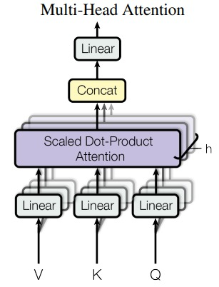

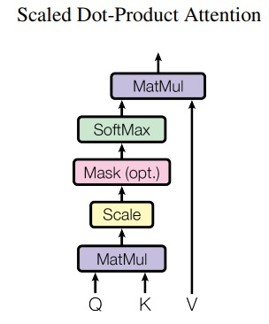
(Masked) Multi-head Attention (MHA)
10
Here, on the output side, we used “masked” MHA because during output generation, we don’t want to look at future tokens
Pic source: “Attention is all you need” (Vaswani et al, 2017)

Slide 11
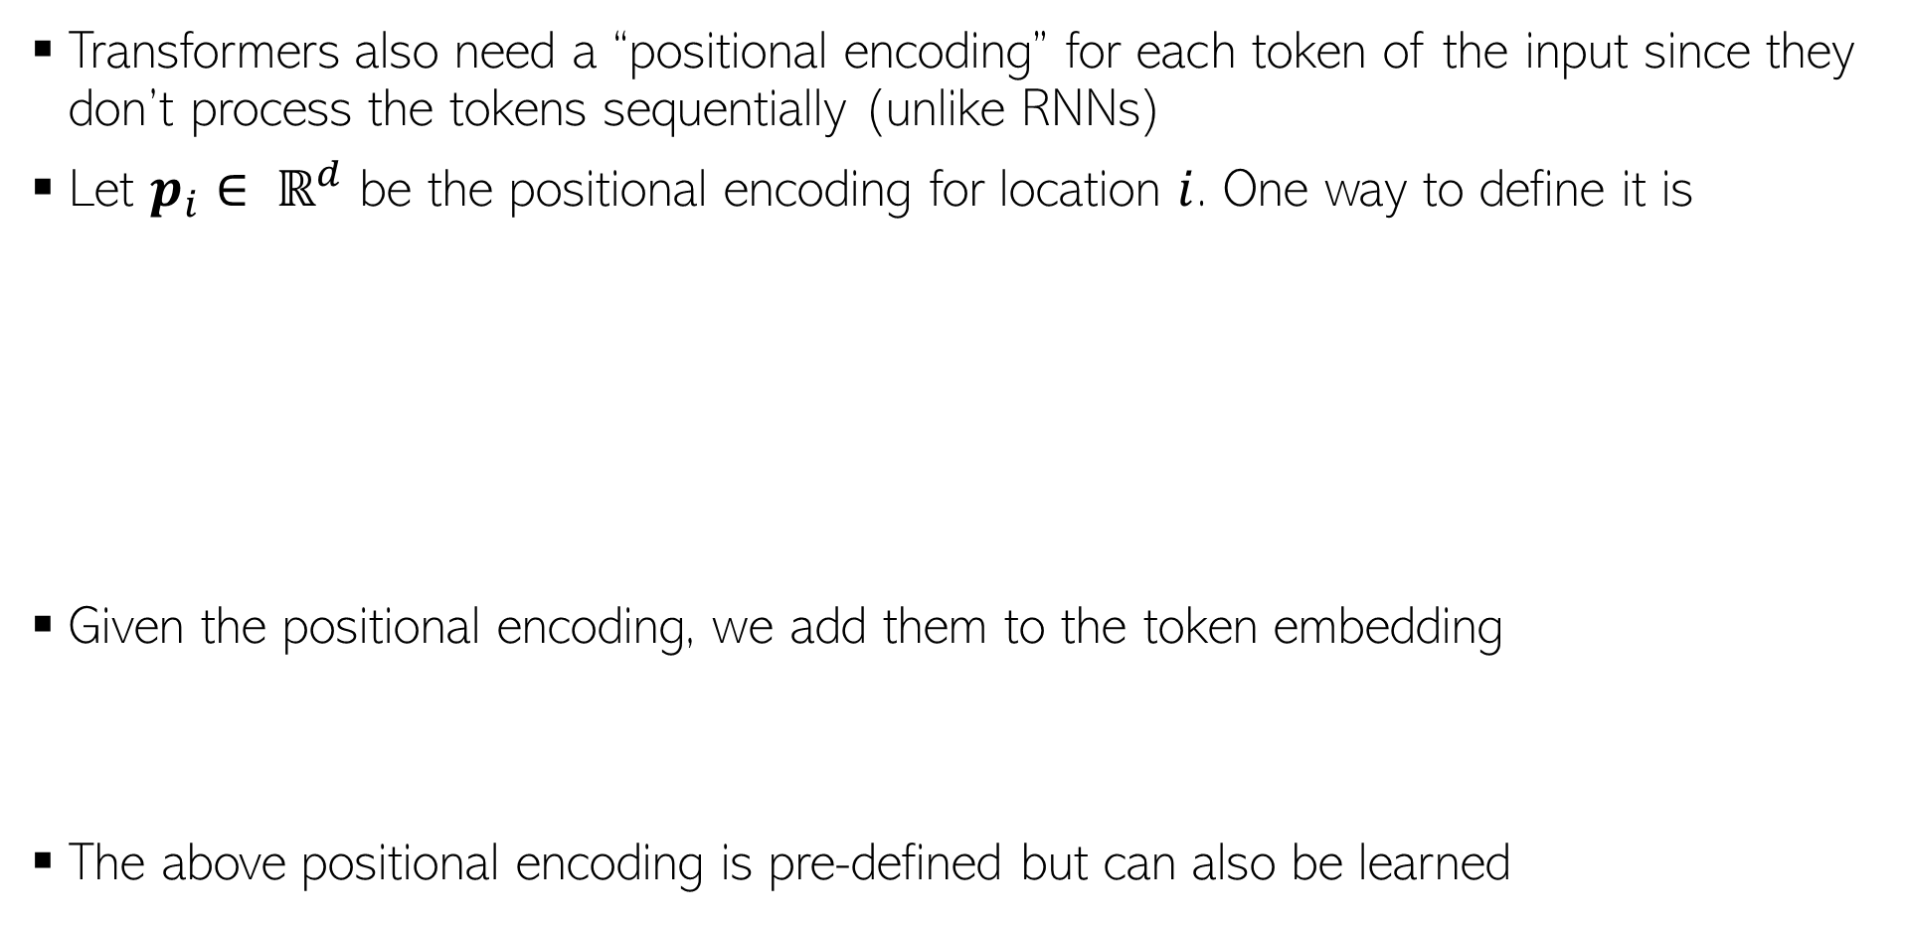
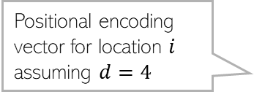
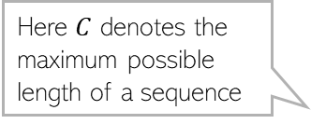

Positional Encoding
11
Transformers also need a “positional encoding” for each token of the input since they don’t process the tokens sequentially (unlike RNNs)
Let $p_{i}∈ ℝ^{d}$ be the positional encoding for location $i$. One way to define it is
Given the positional encoding, we add them to the token embedding
The above positional encoding is pre-defined but can also be learned
Here $C$ denotes the maximum possible length of a sequence
Note the smooth transition as the position index changes
Positional encoding vector for location $i$ assuming $d=4$
$${\hat{x}}_{i}=x_{i}+p_{i}$$
Pic credit: PML-1 (Murphy, 2023)

Slide 12
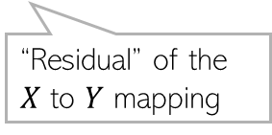
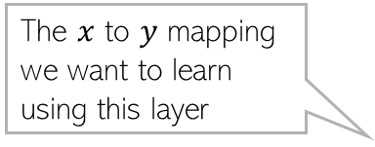
Residual Connections
12
Transformers contain a very large number of layers
In general, just stacking lots of layer doesn’t necessarily help a deep learning model
Vanishing/exploding gradient may make learning difficult
Skip connections or “residual connections” help if we want very deep networks
This idea was popularized by “Residual Networks”* (ResNets) which can have very large number of layers
Basic idea: Don’t force a layer to learn everything about a mapping
Let the layer just learn the “residual” and add the original input
If the residual’s and input’s dimension are different then we apply a projection on the inputs to match the dimensions
The $x$ to $y$ mapping we want to learn using this layer
$$Y=f\left(X;W\right)=g\left(conv\left(X\right)\right)+X$$
“Residual” of the $X$ to $Y$ mapping
*Deep Residual Learning for Image Recognition (He et al, 2015)
Pic credit: PML-1 (Murphy, 2023)

Slide 13
Transformers have many variants
13
BERT (Bidirectional Encoder Representations from Transformers)
GPT (Generative Pretrained Transformer)
T5 (Text-to-Text Transfer Transformer)
Vision Transformers (ViT)

